Slide 1




Development of master curricula for natural disasters risk management in Western Balkan countries
Territorial Seismic Risk Map: a fundamental instrument for prevention
Prof. Giovanni Falsone
University of Messina – Department of Engineering, ITALY
Teaching staff training and study visit
Messina, 19th -21st September 2017
Project number: 573806-EPP-1-2016-1-RS-EPPKA2-CBHE-JP
"This project has been funded with support from the European Commission. This publication reflects the views only of the author, and the Commission cannot be held responsible for any use which may be made of the information contained therein"

Slide 2
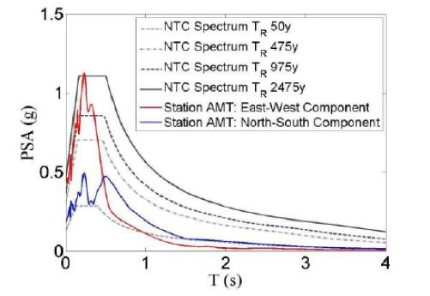
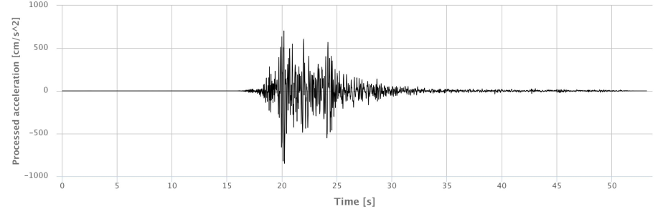
When a catastrophic earthquake happens
Development of master curricula for natural disasters risk management in Western Balkan countries
Two words are always very common in all the news soon after the tragedy:
PREVENTION
REBUILDING
Notes:
Flooding is a global phenomenon which causes widespread devastation, economic damages and loss of human lives.
The Centre for Research on Epidemiology of Disasters (CRED), which promotes research and training on humanitarian emergencies, particularly in public health, launched 30 years ago the Emergency Events Database (EM-DAT). EM-DAT was created with the initial support of the World Health Organisation (WHO) and the Belgian Government.
Basing on this database and together with the UN Office for Disaster Risk Reduction (UNISDR), a report on the human costs of weather-related disasters occurred between 1995 and 2015. According to it, flooding alone accounted for 47% of all weather-related disasters, affecting 2.3 billion people (even if other type of disasters results to be more dangerous in terms of number of lives lost). In this slide, a figure from the report of CRED about natural disasters occurred worldwide during the first semester of 2017, confirming this trend.

Slide 3
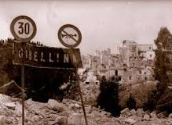
Some catastrophic Italian earthquakes
Development of master curricula for natural disasters risk management in Western Balkan countries
Belice earthquake 15/01/1968 M6.1-6.3
Prevention: absent
Rebuilding: Gibellina was rebuilt 30 Km away, Camporeale was abandoned, in other towns many people lived in the shucks until 90’s.
Notes:
The concept of risk implies a transition from the classical approach of defending a territory from flood hazard, through structural measures that modify the characteristics of the flood event, to the approach of reducing flood risk, through structural and non-structural measures that act on both flood hazard and its consequences. This include a shift away from the single objective of flood defence towards management of flood risks proper through also influencing the vulnerability of society.
Three main developments:
managing all flood events focusing on the idea of coping with risk, instead of defining a design flood event from which implement protections;
risk-informed decision making, so that risk estimates may be used to inform multiple decision makers and the amount invested in risk reduction could be in proportion to risk magnitude and to the cost-effectiveness with which that risk may be reduced;
integrated system approaches, complementing or replacing flood defence by (non-structural) measures for reducing effects of flooding.
Including the possible consequences in flood risk management adds to its implementation all the many variables influencing these consequences, making flood risk management a complex, multi-variate problem facing many uncertainty sources.

Slide 4
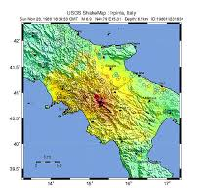
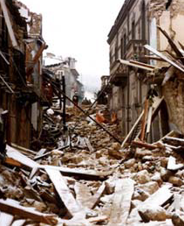
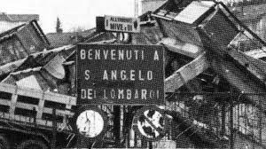
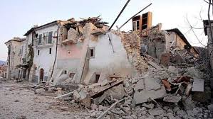
Irpinia earthquake 23/11/1980 M6.9
Development of master curricula for natural disasters risk management in Western Balkan countries
Prevention: absent
Rebuilding: very slow and strongly influenced by the interests of the organized crime.
Notes:
Floods (as any other natural disaster) are much more dangerous when happen in urbanized areas. When talking about floods, a first important distinction has to be made about which flood hazard can affect the urban environment, as river flooding, coastal flooding, flash floods, pluvial flooding.. have different characteristics and can be faced with completely different precautionary and emergency measures. Another aspect to be taken into account is that urban evolution adds to flood risk assessment in future scenarios a great number of uncertain variables (urban growth, changes in exposure and vulnerability, changes in probability of flooding..), thus making flood risk management even more difficult and uncertain.
Defending against future floods will therefore require more robust approaches to flood management that can cope with larger uncertainty or be adaptive to a wider range of futures. This could lead to a greater reliance on more flexible, incremental approaches to flood risk management, the incorporation of greater flexibility into the design of engineered measures, or acceptance of potential over-specification for inflexible measures.

Slide 5
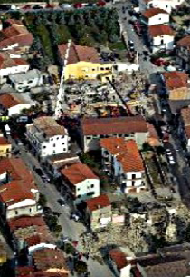
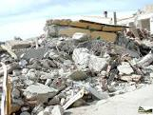
San Giuliano di Puglia 31/10/2002 M5.7
Development of master curricula for natural disasters risk management in Western Balkan countries
Tragedy due to some constructive errors in a retrofitting intervent.
It was the starting point for a new revolutionary code.
Notes:
Flood risk management plans, as pointed out in the European Flood Directive, “shall address all aspects of flood risk management focusing on prevention, protection, preparedness, including flood forecasts and early warning systems” with the aim of “reducing potential adverse consequences of flooding”.
The use of prevention measures that do not interfere on flood’s features require the elaboration of methodologies and strategies aimed at verifying their effectiveness. All over the world, public bodies and academics published some studies on the effectiveness of non-structural measures, but the lack of data on it (or their coarseness) makes their reliability hard to know.
In fact it is not so easy to understand how the use of hazard-independent measures varies the attitude of a territory in suffering a negative event’s consequences.

Slide 6
L’Aquila earthquake 6/4/2009 M5.8
Development of master curricula for natural disasters risk management in Western Balkan countries
Stratecic
structures are strongly damaged or destroyed.
Epicentre distance Km 4.8
Ipocentre depth Km 9.0
Near-source earthquake.
Notes:
If we consider the integral equation of risk, where H is the hazard, V is the vulnerability, E is the entity, the variable describing this attitude is vulnerability, defined exactly as “the characteristics and circumstances of a community, system or asset that make it susceptible to the damaging effects of a hazard”.
Actually, there are different definitions of the term vulnerability with respect to natural hazards research.
From a natural science perspective, studies on vulnerability focus on the susceptibility of physical systems in areas at risk to natural processes, with the aim of providing information useful in risk mitigation strategies.
Vulnerability embodies also the capacity of a system to anticipate, cope with and resist flooding (resistance) and the capacity of the system to recover from the impact of flooding (resilience).
The interpretation assumed here is now reported. Vulnerability is clearly related to the consequences of a natural hazard, which are generally measured in terms of damage or losses. Likewise, given its general connection to elements’ susceptibility, it can be assessed as the expected loss degree of an element (or set element) at risk as a consequence of a hazardous event.
Consequently, vulnerability can assume values ranging from 0 to 1, as the expected degree of loss varies from no damage to complete disruption.

Slide 7


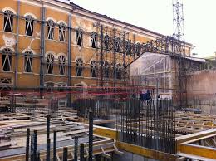
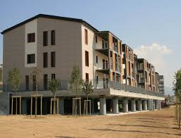
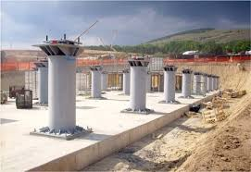
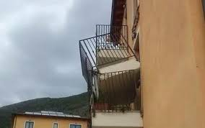
Development of master curricula for natural disasters risk management in Western Balkan countries
L’Aquila earthquake
Prevention: absent
Rebuilding: very slow in the red zone
and too fast in some suburbs
Notes:
So, H describes the severity of the event that may hit a territory with a certain returning period; E is the entity (value) of the elements at risk; V is, for the definition we already gave, the percentage of damage that assets in areas at risk may suffer.

Slide 8
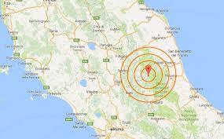
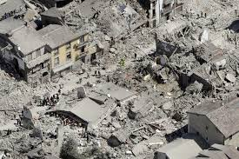
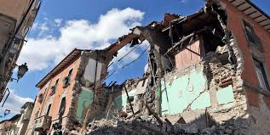


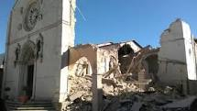
Development of master curricula for natural disasters risk management in Western Balkan countries
Accumoli and Amatrice earthquake 24/8/2016 M6.0
Ipocentre depth 8 Km near-source earthquake
Prevention: only in some territories, like in Assisi
Assisi Norcia
26/9/1997 24/8/2016

Slide 9

Development of master curricula for natural disasters risk management in Western Balkan countries
Prevention or Rebuilding?
Prevention is preferable for - human life safety
- cultural heritage conservation
- economy for the single building
Rebuilding is preferred by rulers and administrators because - is cheaper when an entire territory is considered
- the effects of a prevention action can be seen very late or never seen
- it is necessary while prevention is revocable
prevention
rebuilding
Notes:
In Sicily the risk assessment is currently carried out by means of the use of matrixes which provide flood hazard and flood risk in function of the event return period, the inundation depths and the exposure classes of assets at risk. In this approach, the vulnerability has a constant value preventively equal to 1: this means hypothesize the complete disrupt of every element reached by the water. This methodology substantially give as result how hazard varies in different zones more or less densely populated: in fact, the exposure classes give a general information on buildings (economic and strategic) value and no information on vulnerability variations is included. It does not allow for quantitative assessment of risk (expected damage), which should be useful in flood risk management plans redaction or in cost-benefit analysis for the assessment of the effectiveness of protection strategies. The idea of bypassing the assets’ economical value and using exposure classes, actually, may allow to reduce uncertainties in those cases in which strong databases supporting the analysis lack. Conversely, fixing the vulnerability default value equal to 1 inhibit any assessment of the variations in this parameter and, than, any possible comparison among different combinations of non-structural measures aimed at evaluating their effectiveness.

Slide 10
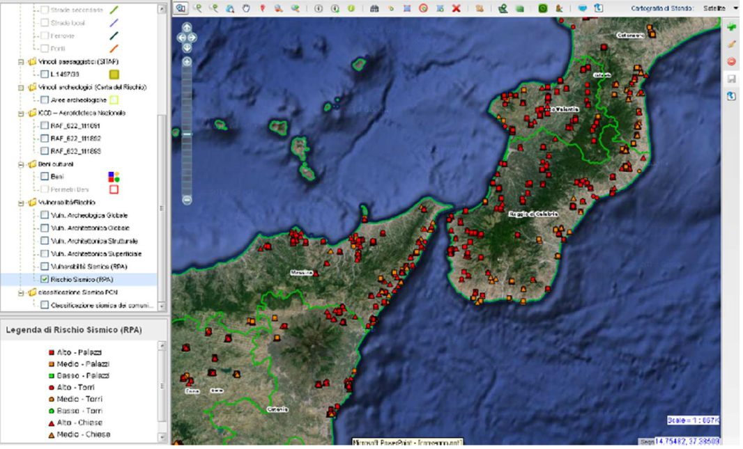
Development of master curricula for natural disasters risk management in Western Balkan countries
Territorial Seismic Risk Map
It is a fundamental instrument when a territory or an administration wants to begin a seismic prevention design but it has not the financial resource for all its structures.
A priority of intervention must be established and the best choice could be that based on the seismic risk level.
Notes:
The term damage embodies a wide range of meanings and interpretation, as it has been and is used by different experts facing different problems, each one dealing with his own discipline (economy, law, medicine, geography, etc.).
Generally speaking, it is possible to find some common lines in these multiple interpretations. Damage is always the consequence of an action or an event; it may affect material or immaterial goods; the preventive assessment of possible damage is the starting point in every risk management strategy.
In general, flood damages are classified as a combination of direct, indirect, tangible and intangible losses. Direct losses are due to the direct contact of elements at risk with the flow; indirect losses include all consequences of the flood event that are not directly connected to the flow such as the disruption of public services and commercial activities after the flood that may even be outside the flood extent. In parallel, tangible losses can be specified in monetary terms, while intangible losses are not traded in a market and cannot be expresses in monetary terms.
Despite in some studies is underlined the consistency of intangible damages, the majority of literature analysis is aimed to the assessment of tangible losses and, in particular, to direct tangible ones. In fact, direct damages are usually present in any damage assessment, indirect losses are often roughly estimated and intangibles are frequently ignored or simply mentioned.
While it is easy to imagine, because of their definition, the difficulties in evaluating intangible losses, even flood tangible damages assessment is still a research challenge: the main obstacles in these research fields are the lack of available and consistent database and the many variables involved in the problem.

Slide 11
Development of master curricula for natural disasters risk management in Western Balkan countries
Seismic Risk of a Structure
V = Seismic Vulnerability of the Structure
E = Economic Exposure of the Structure
P = Seismic Danger of the Site
D = Damage Aptitude of the Structure

Slide 12
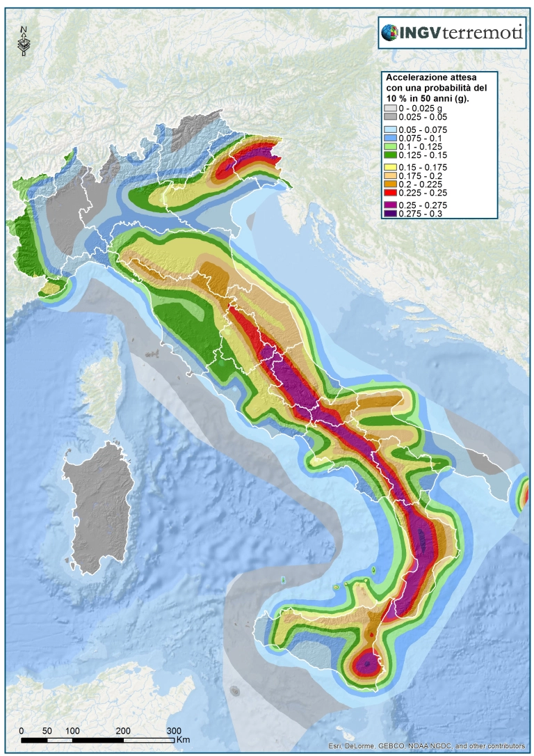
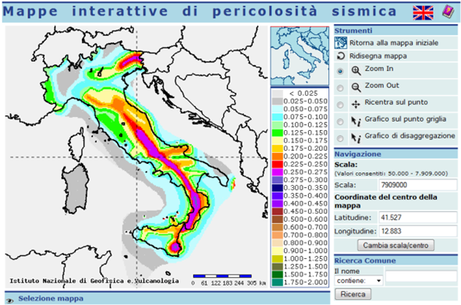
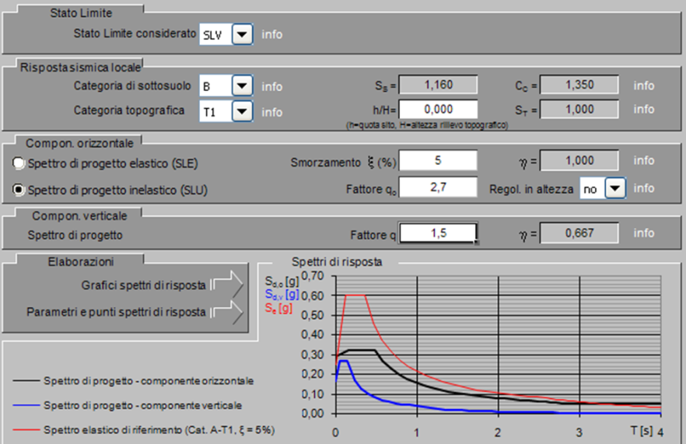
Development of master curricula for natural disasters risk management in Western Balkan countries
Seismic Danger of the Site P
12

Slide 13
SHARE Project
European Seismic Danger Map

Slide 14
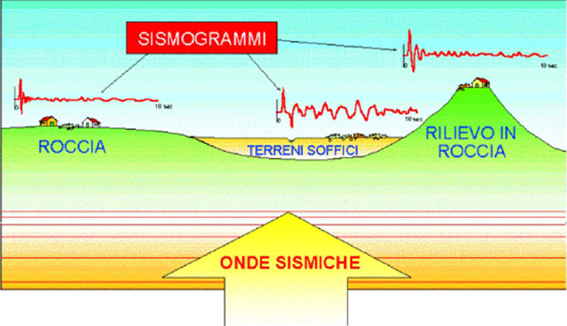
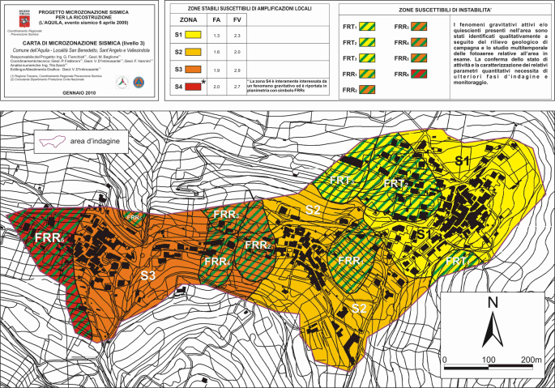
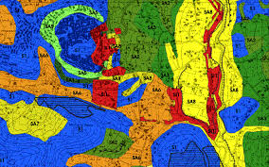
Site Local Effects
Necessity of seismic Micro-Zonation studies
L’Aquila Alatri (FR)

Slide 15
Damage Aptitude of Structures D
Development of master curricula for natural disasters risk management in Western Balkan countries
D is essentially given by the smallest earthquake intensity determining a prescribed crisis on the structure.
It depends only by the structural characteristics.
A fast, but coarse, evaluation of D can be obtained by semiotic methods.

Slide 16
Evaluation of D
Development of master curricula for natural disasters risk management in Western Balkan countries
A more accurate estimate of D is obtained by the methods of the seismic structural analysis.
The choice of the method depends on the characteristics of the structure (masonry, concrete, steel or al.), by the properties of geometric regularity (horizontal and vertical) and by its linear or nonlinear behavior.
In any case, the codes define well the conditions for using a method or another one for both new and existing structures.
D is essentially related to the peak acceleration of the earthquake determining the prescribed crisis on the structure.
16

Slide 17
Development of master curricula for natural disasters risk management in Western Balkan countries
Economic Exposure of Structures E
It depends on - the importance of the structure
- the number of persons per time
The highest level of importance is attributed to strategic structures (hospitals, municipality palaces, police stations, fire stations, etc.).
A great value of E is attributed to the school buildings and to the public office buildings.
17

Slide 18
Development of master curricula for natural disasters risk management in Western Balkan countries
Building a Seismic Risk Map
Digital Platform
18
18

Slide 19
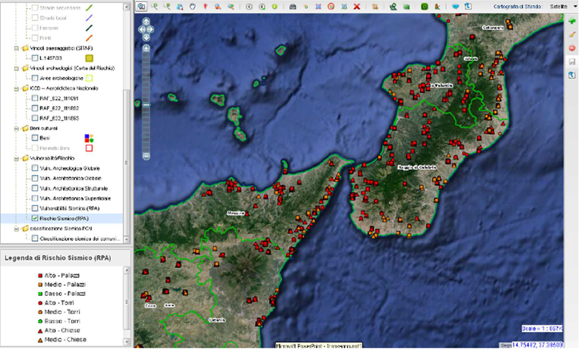
Development of master curricula for natural disasters risk management in Western Balkan countries
Seismic Risk Map
19
19
19

Slide 20
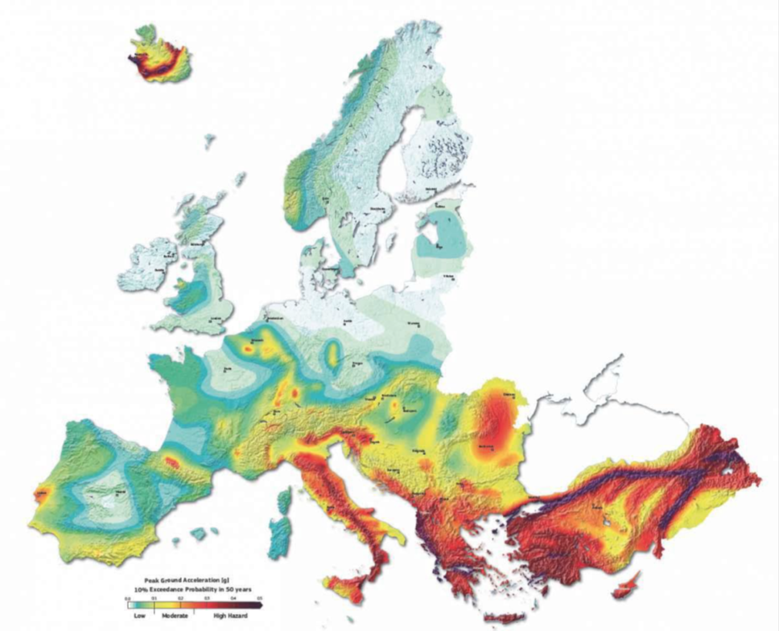
Don’t forget, but learn from the past, taking advantage of the actual knowledge, in order to prevent …
THANK YOU VERY MUCH

Slide 21
Development of master curricula for natural disasters risk management in Western Balkan countries
Isolation and Dissipation Systems for
Seismic Protection of Structures
Prof. Giovanni Falsone
University of Messina – Department of Engineering, ITALY
Teaching staff training and study visit
Messina, 19th -21st September 2017
Project number: 573806-EPP-1-2016-1-RS-EPPKA2-CBHE-JP
"This project has been funded with support from the European Commission. This publication reflects the views only of the author, and the Commission cannot be held responsible for any use which may be made of the information contained therein"

